Slide 1

IPL Team Analysis – RCB Strategy for Mega Auction 2017 Presented By: Tushar Gupta

Slide 2
Problem Statement
RCB is preparing for the 2017 Mega Auction and wants to build a strong, well-balanced team. To achieve this, we need to analyze past IPL seasons and identify: ✅ Players who have consistently performed well. ✅ Strengths and weaknesses in RCB’s current squad. ✅ Insights from data that can help in selecting the right players.
This study focuses on data-driven decision-making using SQL-based analysis.

Slide 3
Database Schema
The dataset consists of multiple tables that store IPL match details, player stats, and performance metrics.
Main Tables Used:
matches – Stores match details such as match date, teams, venue, winner, and toss decision.
ball_by_ball – Contains detailed information for every ball bowled, including runs, extras, batsman, bowler, and over details.
player – Includes player details such as player name, team, and playing role (batsman, bowler, all-rounder).

Slide 4
wickets_taken – Records details of every wicket taken, including the bowler and the dismissed batsman.
extra_runs – Stores information on extra runs given (wides, no-balls, leg byes).
venue – Provides information about match venues and their respective cities.
season – Lists all IPL seasons along with their unique season IDs.
batting_style – Defines whether a player is a right-handed or left-handed batsman.
bowling_style – Stores information on players' bowling types (e.g., right-arm fast, left-arm spin).
player_match – Links players to the matches they played in.

Slide 5
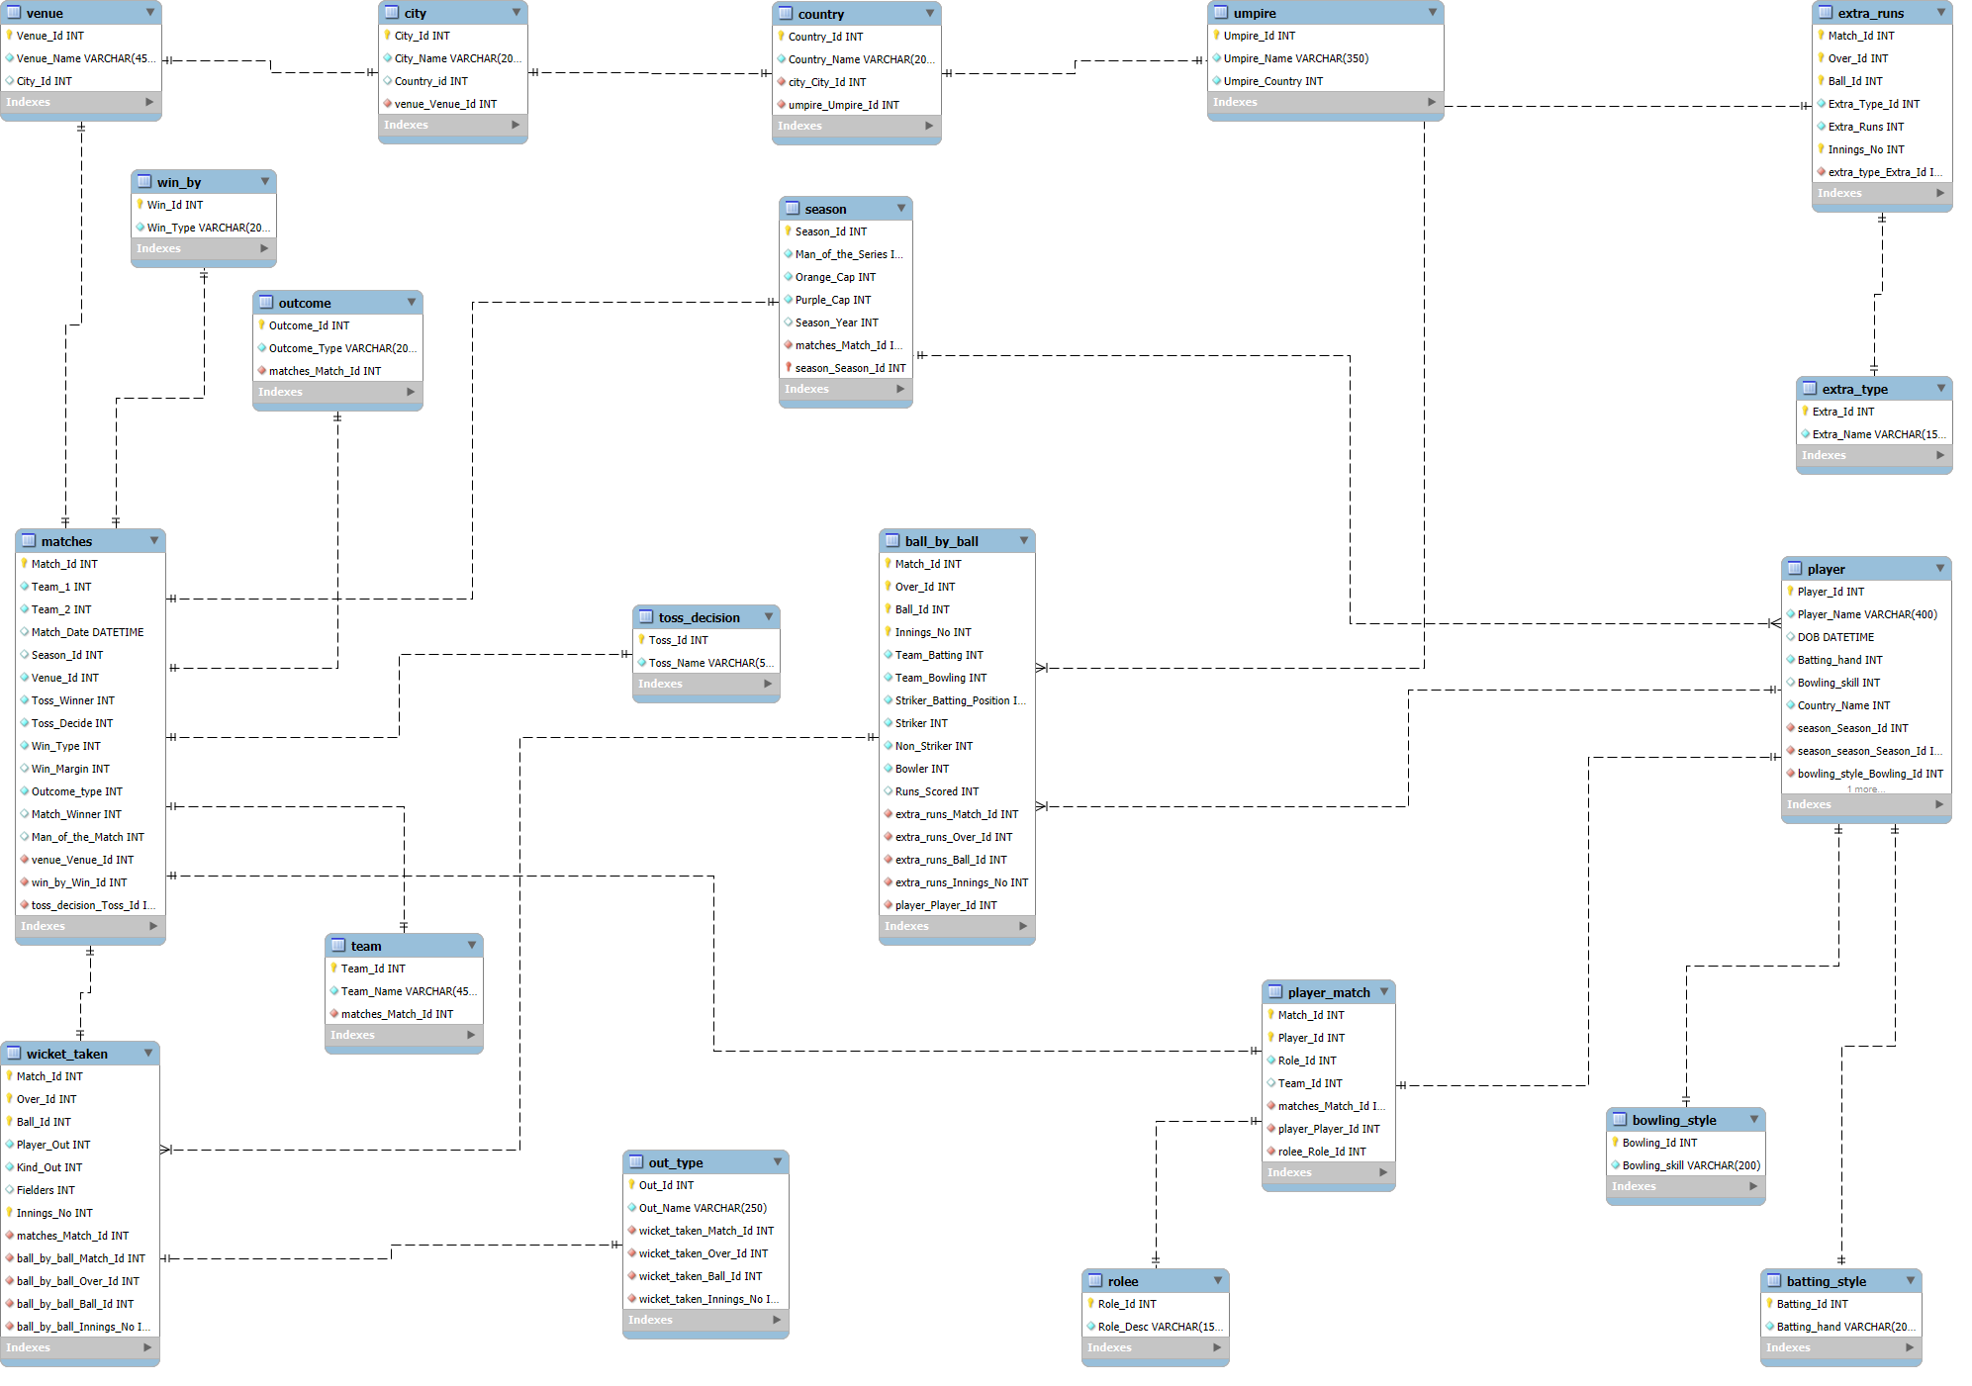
Entity Relationship Diagram

Slide 6
Players with High Strike Rate
Objective: To identify aggressive batsmen who can score runs quickly.
Method:
✅ We calculate Strike Rate (SR) = (Total Runs / Balls Faced) × 100 ✅ Considered batsmen who have played at least 250 balls for reliability. ✅ Sorted players in descending order of strike rate.
Findings:
Top performers include AB de Villiers, Chris Gayle, and MS Dhoni.
These players can accelerate the scoring rate and change the game quickly.

Slide 7
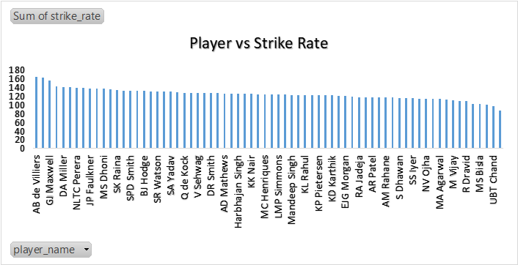
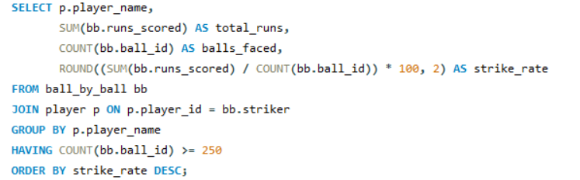

Slide 8
Best Batting Average
Objective: To find batsmen who consistently score runs across seasons.
Method:
✅ Batting Average = Total Runs / Innings Played ✅ Used data from multiple IPL seasons for better accuracy.
Findings:
Players like SE Marsh and LMP Simmons have the highest batting averages.
These batsmen are valuable for building partnerships and stabilizing the innings.

Slide 9
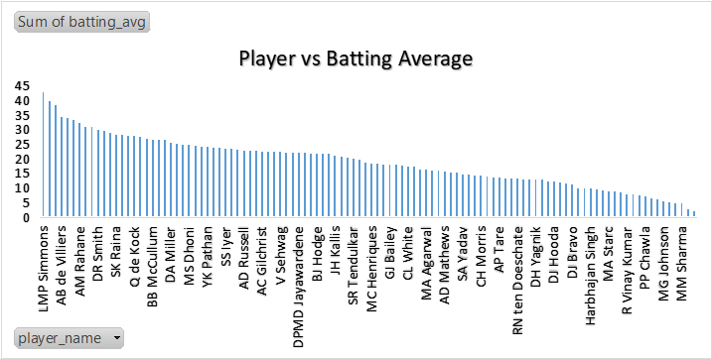
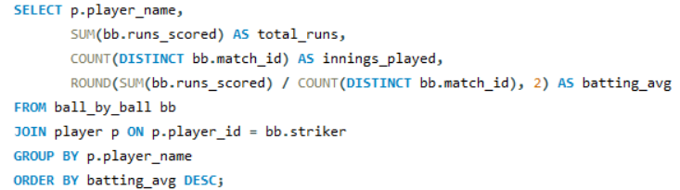

Slide 10
Best Bowling Average
Objective: To identify bowlers who are most effective in taking wickets.
Method:
✅ Bowling Average = Total Wickets / Matches Played ✅ Focused on players who have bowled in at least 10 matches.
Findings:
Bowlers like DAJ Bracewell and YA Abdulla have the best bowling averages.
These bowlers should be targeted in the auction for their consistent wicket-taking ability.

Slide 11
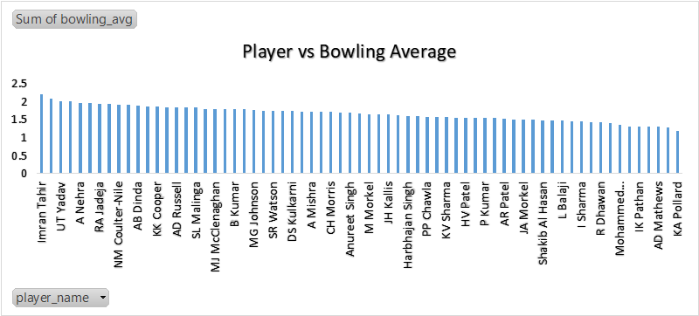
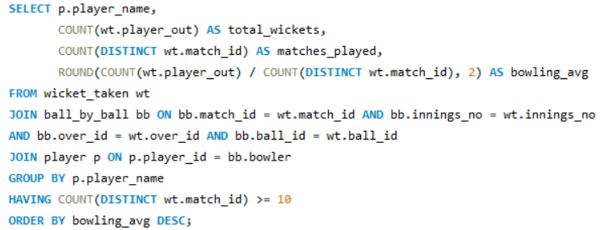

Slide 12
Home Ground Performance
Objective: To analyze RCB’s win percentage at their home ground.
Method:
✅ Filtered matches where RCB played at M. Chinnaswamy Stadium. ✅ Compared the number of wins and losses.
Findings:
RCB has a strong record at M. Chinnaswamy Stadium.
Home advantage plays a crucial role in their performance.

Slide 13
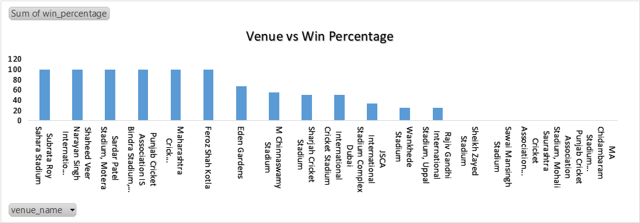
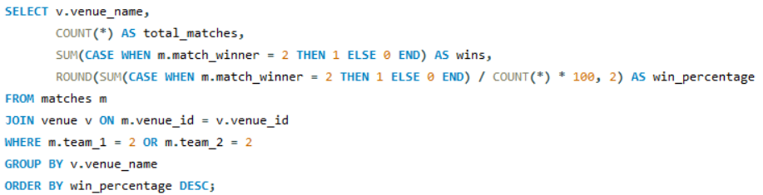

Slide 14
Bowling Style Analysis
Objective:
To determine which bowling styles are most effective in IPL.
Findings:
Right-arm medium pacers took the highest number of wickets.
RCB should focus on recruiting bowlers with this style.

Slide 15
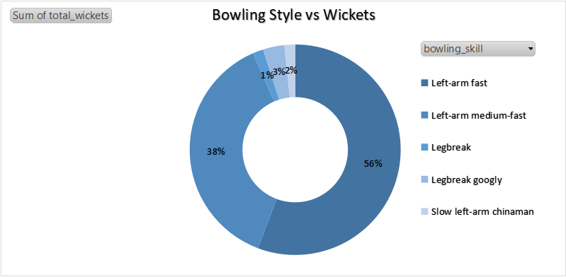
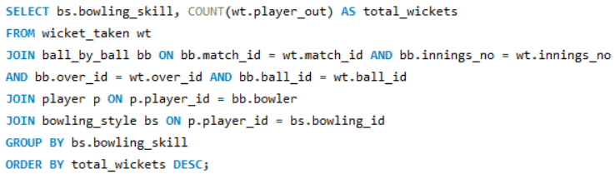

Slide 16
Toss Impact and Venue Analysis
Objective:
To see if winning the toss helps teams win more matches.
Findings:
At some venues, toss winners have a high win percentage.
RCB should consider batting first at home to maximize their chances.

Slide 17
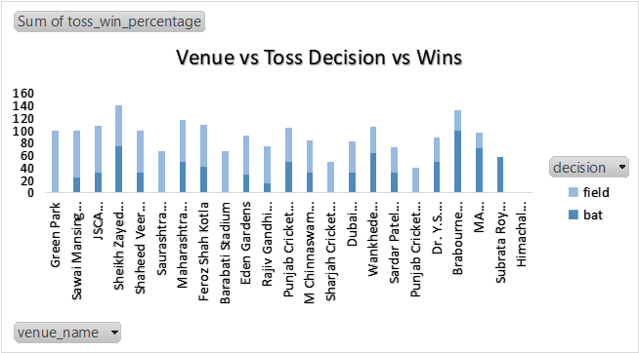
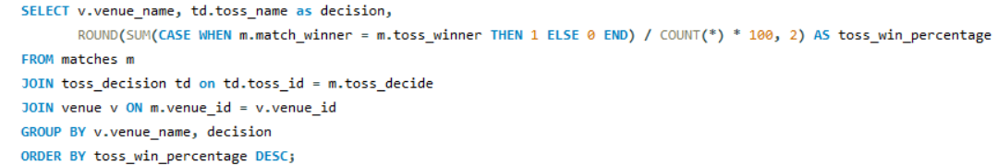

Slide 18
KPI’s for RCB
To evaluate RCB’s overall performance, we have calculated key metrics that highlight strengths and areas of improvement.
KPIs Considered:
1. Batting Performance Metrics:
Average Runs per Match → Measures RCB’s consistency in scoring.(27.43)
Strike Rate → Determines how aggressively the team scores runs.(137.6)
Boundary Percentage → Percentage of total runs coming from boundaries.(56.8%)

Slide 19
2. Bowling Performance Metrics:
Economy Rate → Average runs conceded per over.(163.4)
Wicket-taking Ability → Wickets per match.(6.4)
Death-Over Economy → Performance in the final 4 overs of an innings.(10.9)
3. Overall Team Performance Metrics:
Win Percentage at Home → Effect of venue on performance.(58.3%)
Toss Win Impact → Matches won when RCB won the toss.(54.6%)

Slide 20
Conclusion & Recommendations
Key Takeaways:
✅ Retain top performers like Kohli, Gayle, and de Villiers.
✅ Invest in death-over bowlers with low economy rates.
✅ Prioritize all-rounders for a balanced squad.
✅ Use home-ground advantage by focusing on batting first.

Slide 21

THANK YOU

